Slide 1
ABC Communications Ltd Churn Analysis

Slide 2
Content
Objective
Customer Demographics
Churn Drivers
Insights
Risks and Opportunities
Recommendations

Slide 3

Objective
ABC Communications is trying to understand why its customers churn and needs retention strategies to help them keep their customers.
They also want to understand their customer base better and how their customers interact with the company to help them identify risks and opportunities.

Slide 4
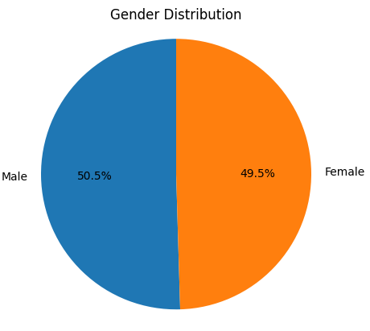
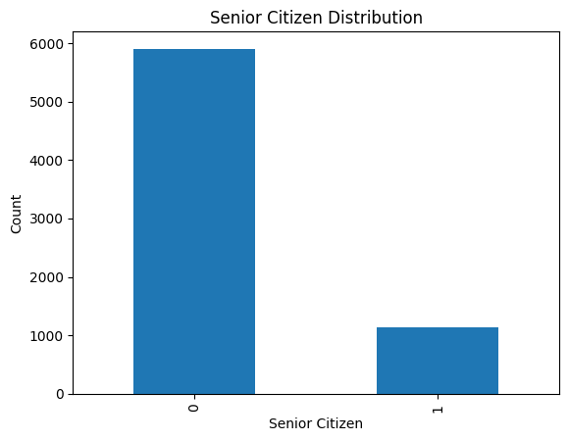
Customer Demographics
Client gender is almost evenly distributed, with males representing 50.5% and females 49.5%.
16.2% of clients are senior citizens and 83.8% are non-senior citizens.

Slide 5
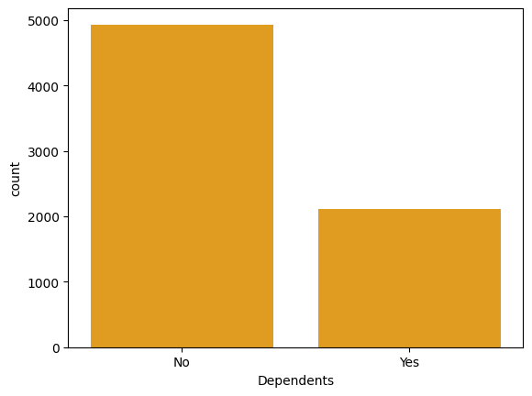
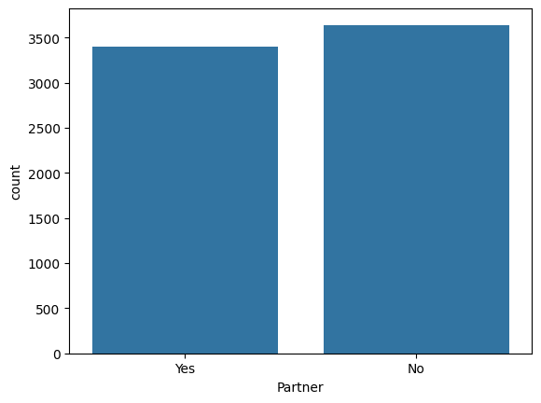
Customer Demographics
30% of clients have dependents.
48.3% of clients have partners.

Slide 6
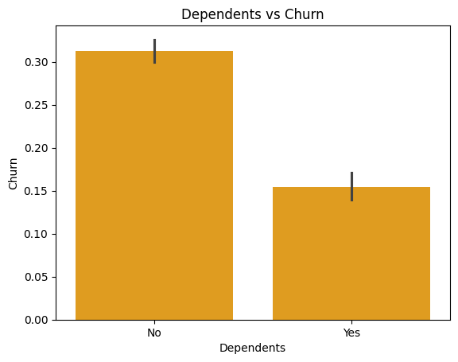
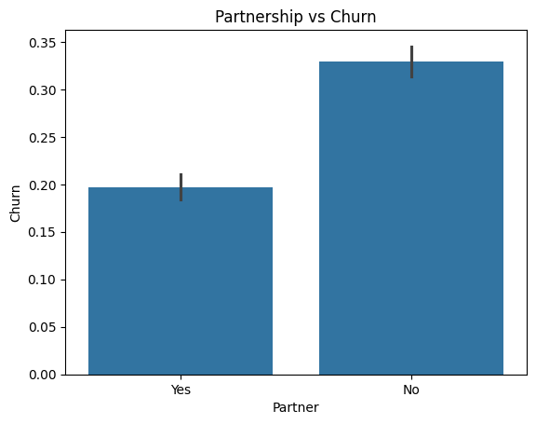
Churn Drivers
Clients with dependents have a low churn rate of 15.5% compared to 31.3% among those who don’t.
Clients with partners churn at 19.7% compared to 33% for those without partners.

Slide 7
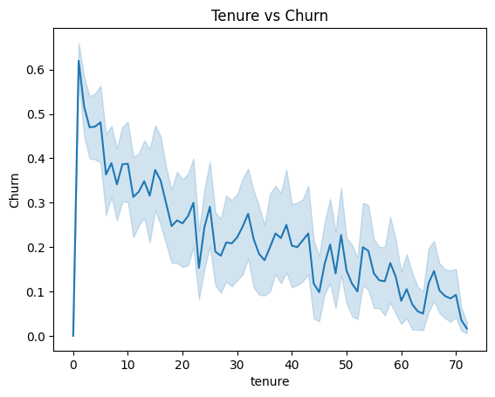
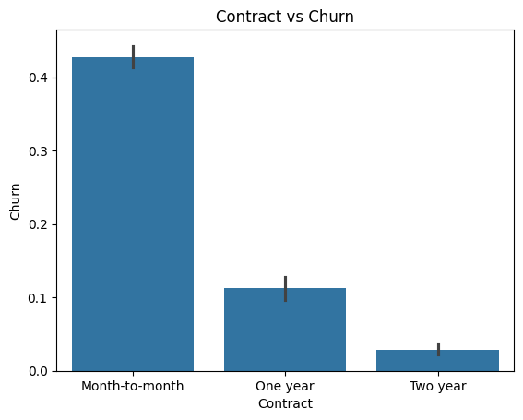
Churn Drivers
Churn is very high during the first few months then is weaker as the customer stays longer.
Month-to-month clients churn almost as twice as much as longer contract clients.

Slide 8
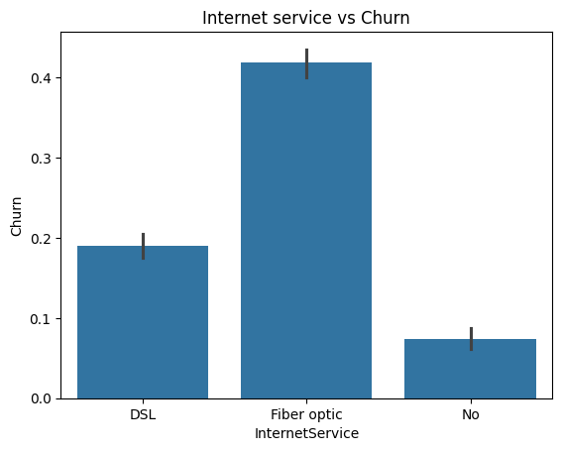
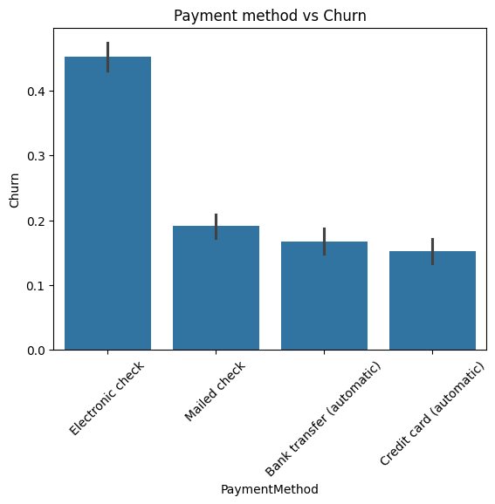
Churn Drivers
41.9% of clients with Fiber optic internet service churned.
45.3% of clients who pay via electronic check churned.

Slide 9
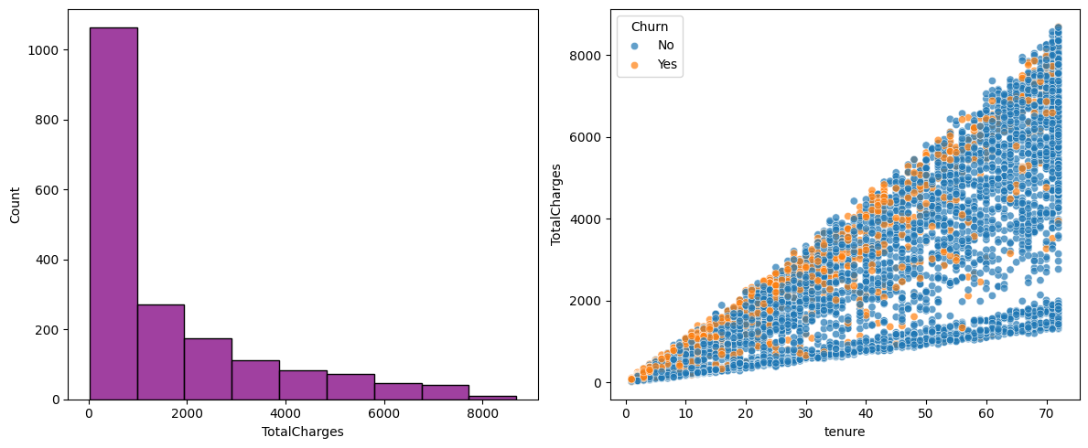
Proxy Variable
Total charges show a steady negative relationship with the number of clients who churned and they also show a strong positive correlation with tenure.

Slide 10
Insights
Customers with dependents churn at half the rate of those without.
Customers on longer contracts are more stable, while month‑to‑month clients are more exposed to lapses in renewal or preference‑driven exits.
Clients who pay via electronic check show a significantly higher churn rate than other payment methods.
Clients who use Fiber optic internet service are the most likely to churn in this segment.
New clients form the largest group of churners, with churn risk concentrated in the early months of tenure.

Slide 11
Risks and Opportunities
RISKS:
OPPORTUNITIES:
High churn among month‑to‑month clients.
Fiber optic service dissatisfaction.
Electronic check payment instability.
Promote long‑term contracts.
Target households with dependents.
Frontload retention for new clients .

Slide 12
Recommendations
Target households with dependents through family‑oriented bundles and loyalty programs.
Promote long‑term products and consider incentives such as discounts or bundled services to encourage customers to commit to longer contracts.
Investigate the underlying causes of high churn among electronic check users and Fiber optic customers. This may involve analysing customer support interactions, billing issues, or service quality to identify pain points.
Frontload retention strategies during the onboarding period rather than applying them later. Early engagement, welcome offers, and proactive support should be prioritized to reduce churn among new clients.
Consider targeted retention strategies for digital customers.

Slide 13
Thank you.

